Slide 1
A Hybrid NLP-Based Chatbot for Medical symptom Analysis and knowledge Retrieval Using Labeled Datasets and Encyclopedic Resources.
B.Sc. Final-Defense
Name: Mehedi Hasan
ID : 221-15-4680
Department : CSE
Daffodil International University

Slide 2
Outline
Introduction
Objective
Background Study
Gap Analysis
Methodology
Results & Analysis
Novelty of the Work
Sample Dataset & Expected Output
Web Interface
Conclusion
References
B.Sc. Final-Defense

Slide 3
Introduction
Problem Statement:
Global healthcare systems are overwhelmed by resource shortages and diagnostic delays, leading patients to rely on unverified online searches. Current AI tools like ChatGPT are powerful but unsafe they often function as "black boxes“ prone to hallucinating medical facts without evidence making them unsafe for clinical decision support.
Proposed Solution:
HybridMed-AI addresses these gaps by deploying a Cascading ML & DL Architecture that intelligently routes queries for maximum accuracy. For response generation, it utilizes Llama 3.1 (fine-tuned on the Gale Encyclopedia of Medicine). This fine-tuning, combined with Retrieval-Augmented Generation (RAG), strictly eliminates hallucinations and ensures every output is grounded in verified medical literature.
Key Focus: Balancing high predictive accuracy with transparent, evidence-based explanations for clinical decision support.
B.Sc. Final-Defense

Slide 4
Objective
Hybrid System Design: Develop a cascading architecture combining fast ML classifiers and complex Transformer models. Assess performance across multiple metrics (Accuracy, F1-score, Precision, Recall) on standardized datasets.
Evidence Integration: Implement RAG to ground diagnostic outputs in the Gale Encyclopedia of Medicine.
Explainability: Incorporate LIME and SHAP to provide transparent, token-level justifications for predictions.
User Trust: Ensure clinical reliability through confidence scoring and citation-supported explanations.
B.Sc. Final-Defense

Slide 5
Background Study
Study / System | Methodology | Critical Limitation (The Gap)
Gargari et al. (2025) | Standard RAG + LLM | Generic retrieval; prone to "hallucinations" on specific symptoms.
SymptoTrackAI (2025) | Oncology-specific RAG | Narrow Domain: Only works for cancer; fails on general diseases.
Standard LLMs | GPT-4 / Llama 3 | Black Box: No citations; cannot verify if advice is medical fact or guess.
MRD-RAG | Multi-Reasoning RAG | Slow Latency: Too computationally heavy for real-time chat.
Kumar et al. (2024) | Symptom-based ML Classification | Lack of Explainability: High accuracy (95%) but functions as a "Black Box" with no justification for predictions.
Mahajan et al. (2023) | Standard Ensemble Learning | Lower Accuracy Cap: Achieved only ~92-95% accuracy; failed to resolve complex cases without Deep Learning integration.
B.Sc. Final-Defense

Slide 6
Gap Analysis
Feature | SymptoTrackAI [6] | MRD-RAG [14] | Orthopedic Chatbot [5] | ML Chatbot [11] | HybridMed-AI (Proposed)
Cascading ML-DL Architecture | No | No | No | No | Yes
RAG Integration | Yes | Yes | Yes | No | Yes
Explainability with Citations | Partial | Yes | Partial | No | Yes
Full-Stack Deployment | No | No | Yes | Partial | Yes
Confidence Thresholding | No | Partial | No | No | Yes
Biomedical Transformer Fine-Tuning | No | No | No | No | Yes
Authoritative Knowledge Base | Partial | Yes | Partial | No | Yes (Gale Encyclopedia)
Multi-Class Disease Coverage | Limited | Moderate | Limited | Moderate | Comprehensive (24 diseases)
B.Sc. Final-Defense

Slide 7
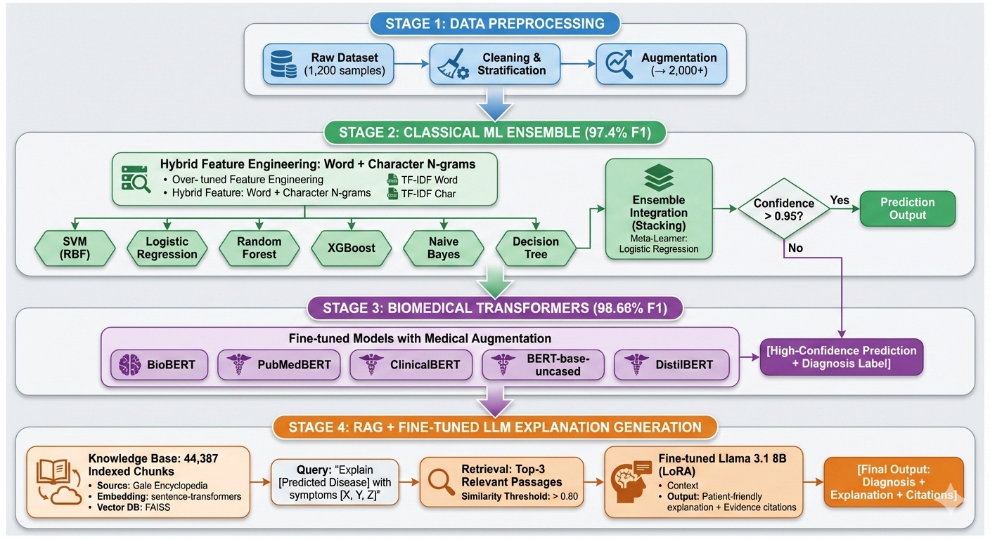
Methodology
Figure: Hybrid System Architecture
B.Sc. Final-Defense

Slide 8
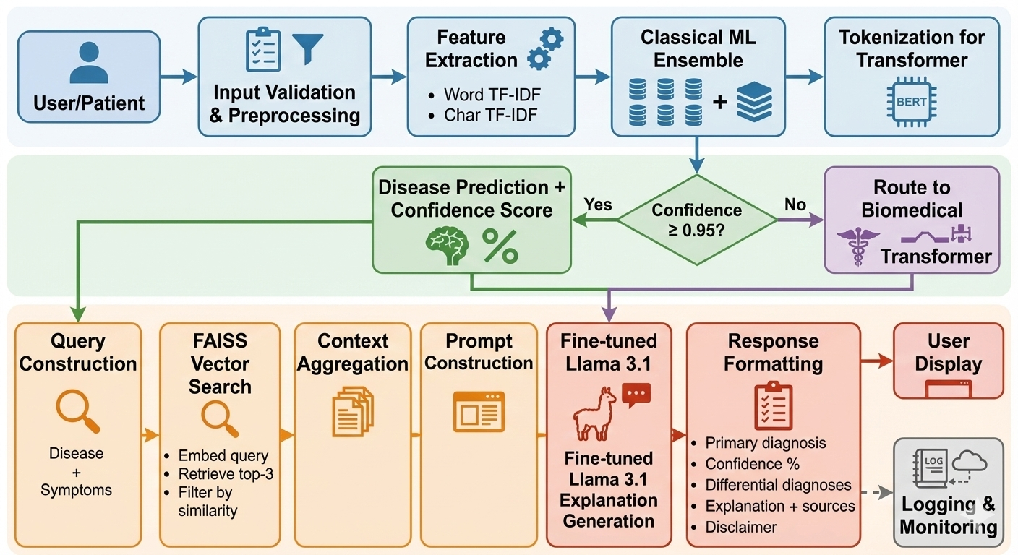
Methodology Cont.
Figure: Data Flow Diagram
B.Sc. Final-Defense

Slide 9
Machine Learning Models Result and Analysis
Table: Machine Learning Models Performance
Model | CV F1 (Mean ± SD) | Val F1 | Val Acc | Val Prec | Val Rec | Val MCC | Val Kappa | Training Time (s)
SVM-RBF | 0.9834 ± 0.0071 | 0.9872 | 0.9902 | 0.9875 | 0.9870 | 0.9869 | 0.9866 | 8.2
Logistic Regression | 0.9831 ± 0.0069 | 0.9870 | 0.9898 | 0.9872 | 0.9868 | 0.9865 | 0.9862 | 3.4
Random Forest | 0.9497 ± 0.0154 | 0.9543 | 0.9640 | 0.9558 | 0.9530 | 0.9528 | 0.9518 | 12.7
XGBoost | 0.8642 ± 0.0203 | 0.8747 | 0.8954 | 0.8802 | 0.8698 | 0.8693 | 0.8675 | 45.3
SVM-Linear | 0.9731 ± 0.0089 | 0.9783 | 0.9837 | 0.9785 | 0.9780 | 0.9777 | 0.9770 | 1.8
Naive Bayes | 0.9421 ± 0.0178 | 0.9478 | 0.9576 | 0.9492 | 0.9465 | 0.9461 | 0.9448 | 2.1
Stacking Ensemble | 0.9968 ± 0.0023 | 1.0000 | 1.0000 | 0.9870 | 0.9870 | 1.0000 | 1.0000 | 68.9
B.Sc. Final-Defense

Slide 10
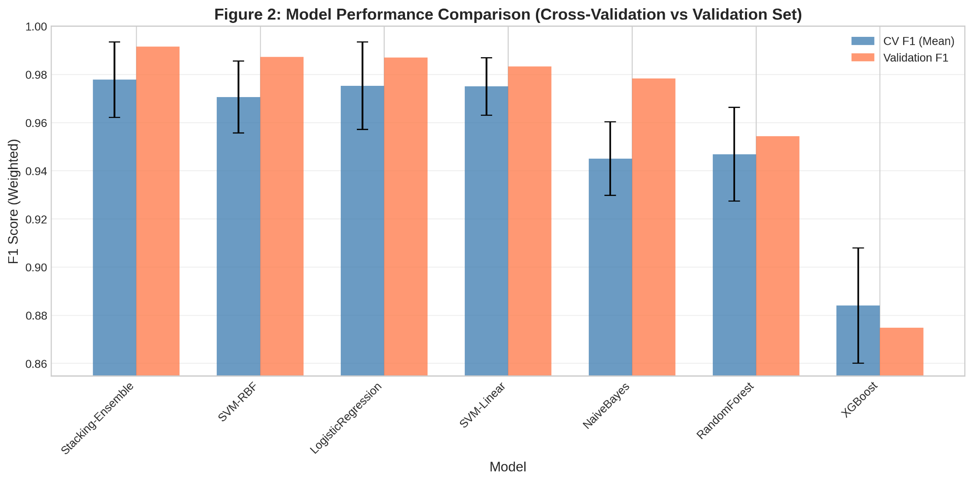
Machine Learning Models Result and Analysis
Figure: Machine Learning Model Performance Comparison (Cross-Validation vs Validation Set)
B.Sc. Final-Defense

Slide 11
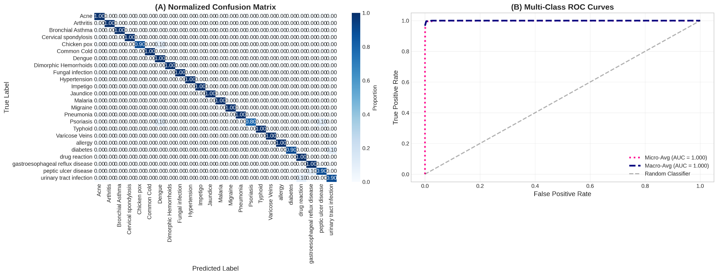
Machine Learning Models Result and Analysis
Figure: (A) Normalized Confusion Matrix and (B) Multi-Class ROC Curves – ML Ensemble
B.Sc. Final-Defense

Slide 12
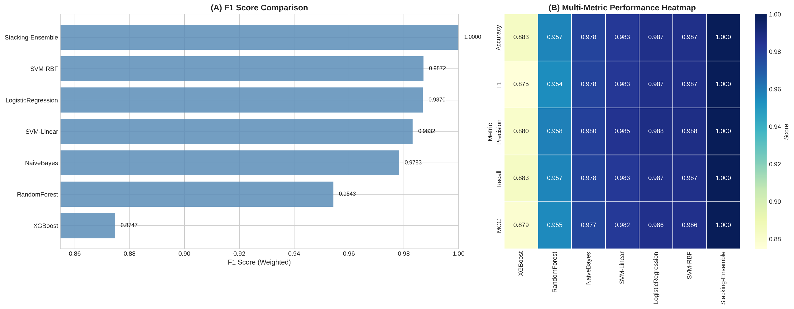
Machine Learning Models Result and Analysis
Figure: (A) ML Model F1 Score Comparison and (B) Multi-Metric Performance Heatmap
B.Sc. Final-Defense

Slide 13
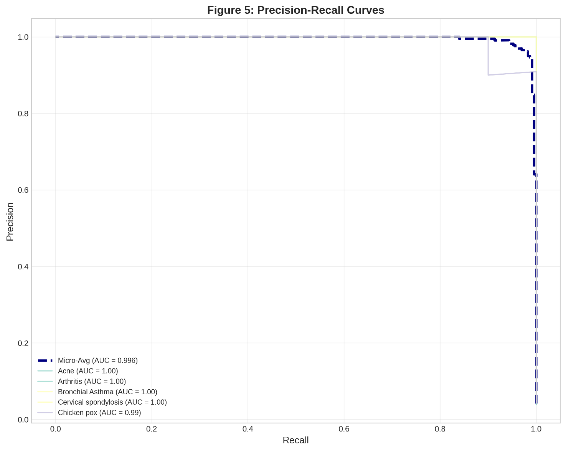
Machine Learning Models Result and Analysis
Figure: Precision–Recall Curves – ML Ensemble
B.Sc. Final-Defense

Slide 14
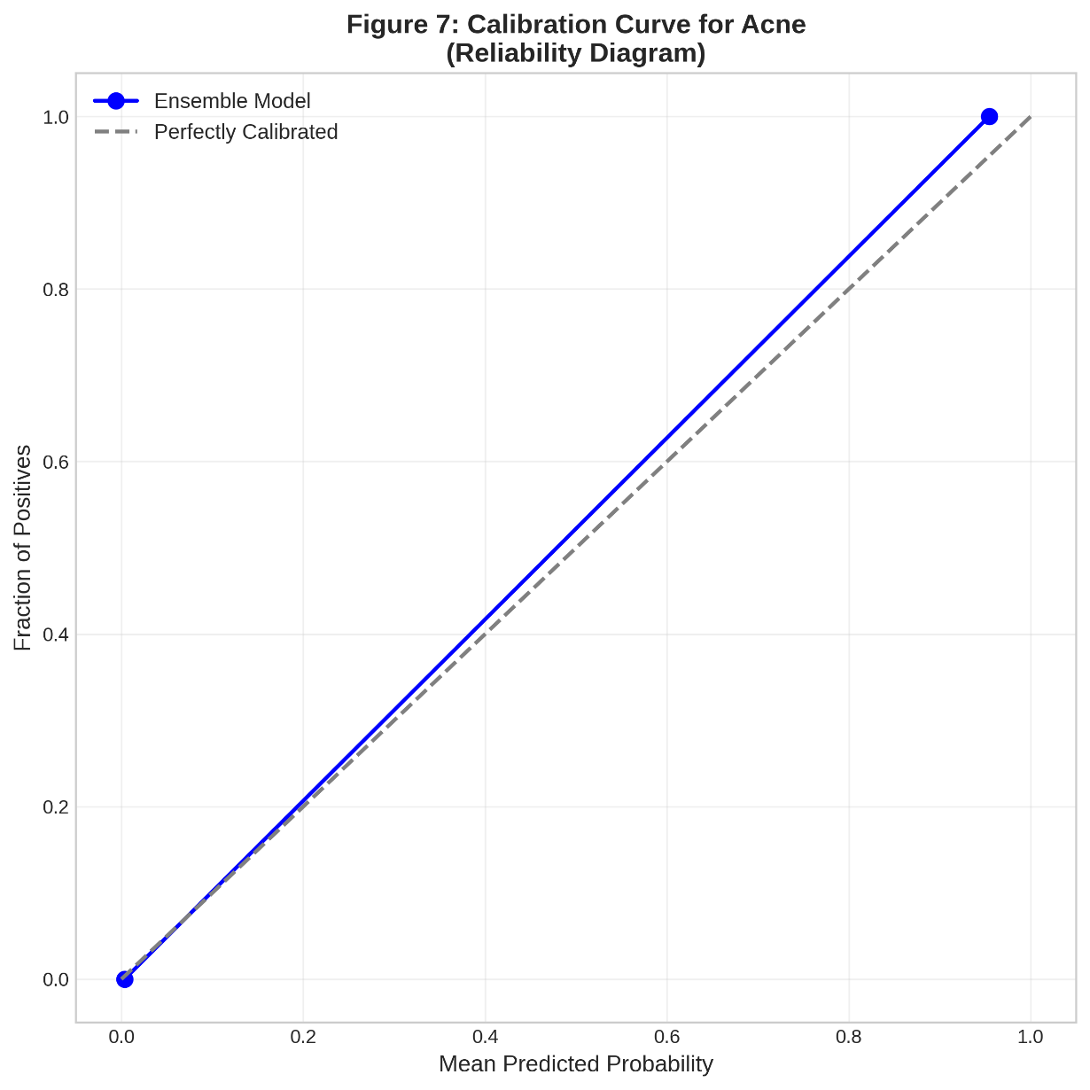
Machine Learning Models Result and Analysis
Figure: Calibration Curve for Acne (Reliability Diagram)
B.Sc. Final-Defense

Slide 15
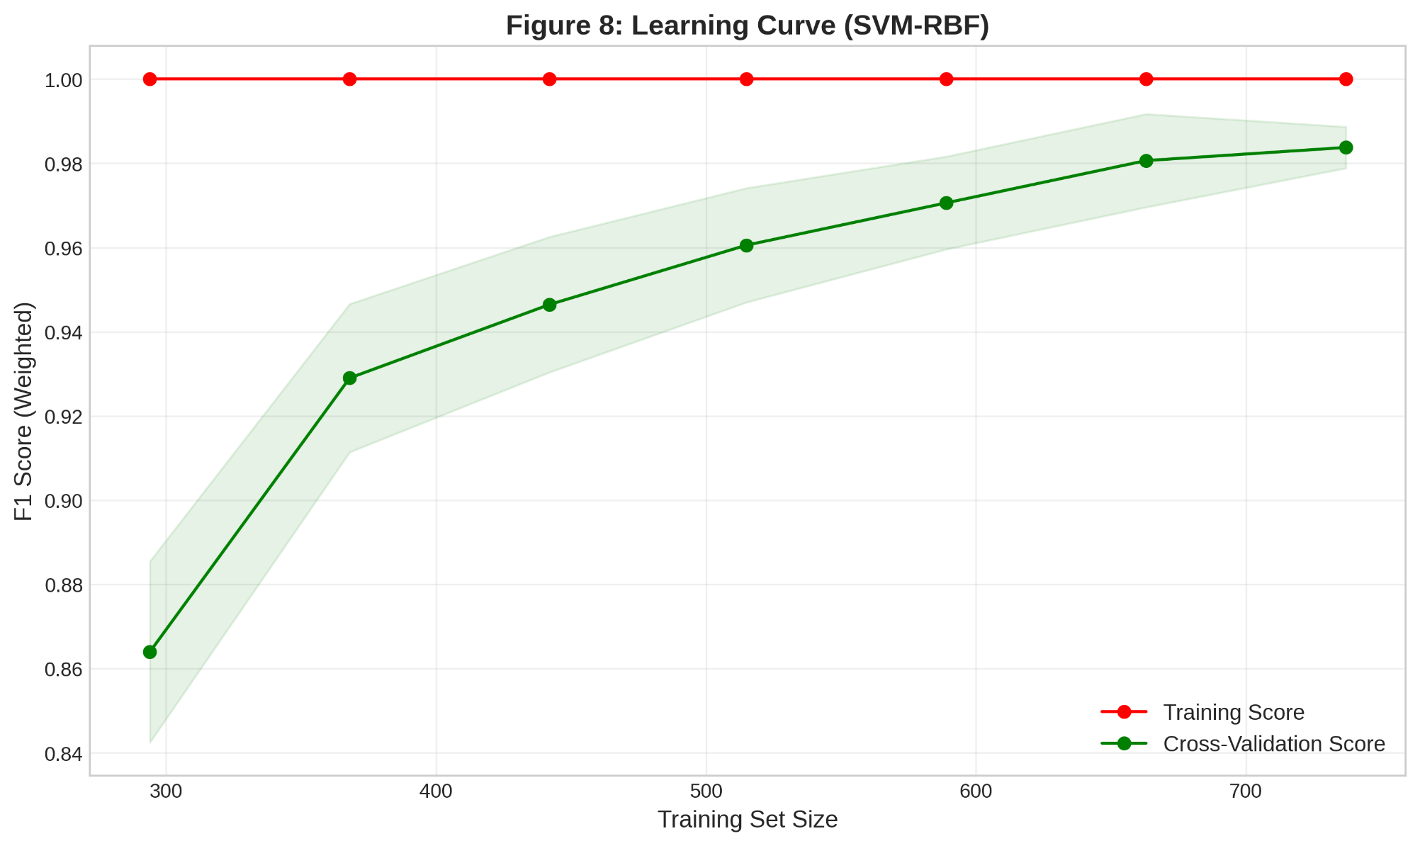
Machine Learning Models Result and Analysis
Figure: Learning Curve – SVM with RBF Kernel
B.Sc. Final-Defense

Slide 16
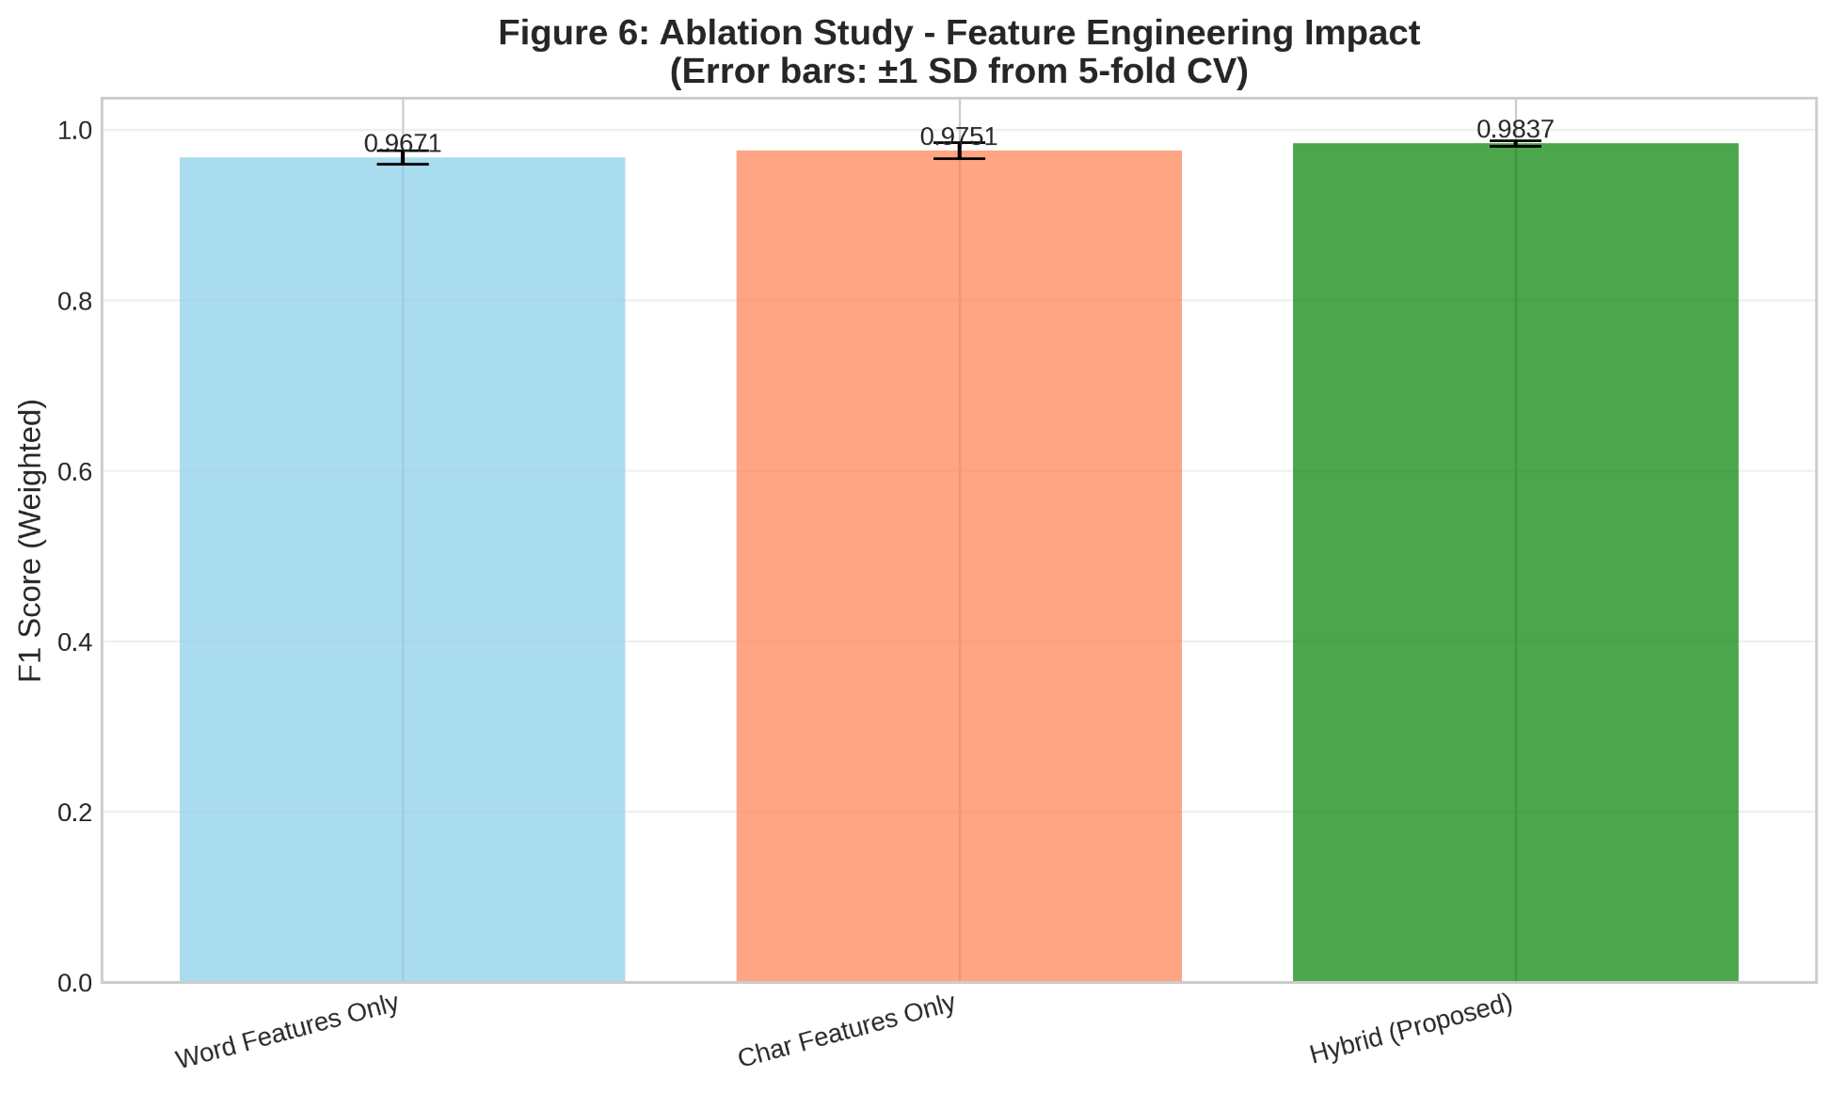
Machine Learning Models Result and Analysis
Figure: Ablation Study – Feature Engineering Impact (Error Bars: ±1 SD from 5-Fold CV)
B.Sc. Final-Defense

Slide 17
Machine Learning Models Result and Analysis
Statistical Significance & Reliability Analysis:
McNemar's Test: SVM-RBF vs Ensemble
χ² statistic: 0.8000
p-value: 0.3711
Result: No significant difference
⏳ Computing 95% Bootstrap Confidence Intervals...
95% Confidence Interval for F1 Score:
F1 = 0.9739 [95% CI: 0.9514 - 0.9914]
B.Sc. Final-Defense

Slide 18
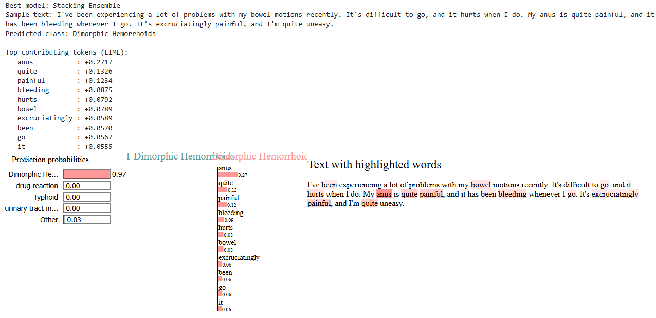
Machine Learning Models Result and Analysis
ML Model Explainability & Trust (LIME):
B.Sc. Final-Defense

Slide 19
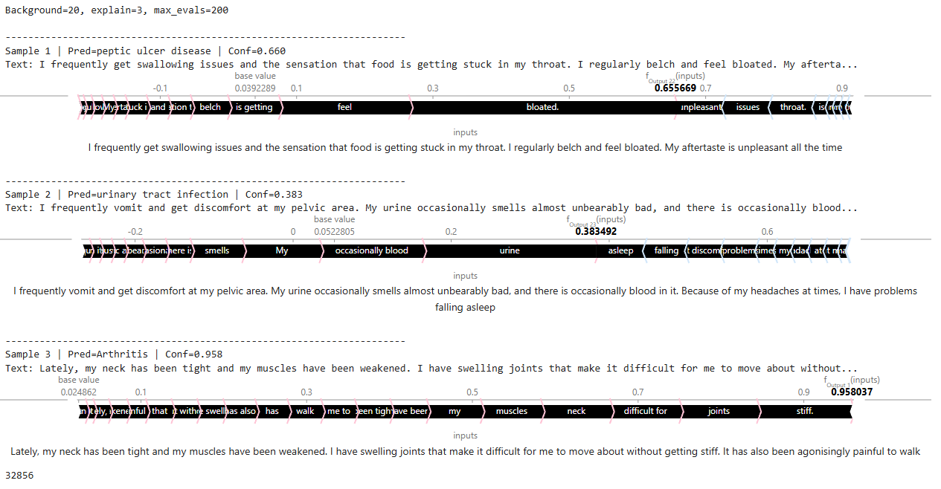
Machine Learning Models Result and Analysis
ML Model Explainability & Trust (SHAP):
B.Sc. Final-Defense

Slide 20
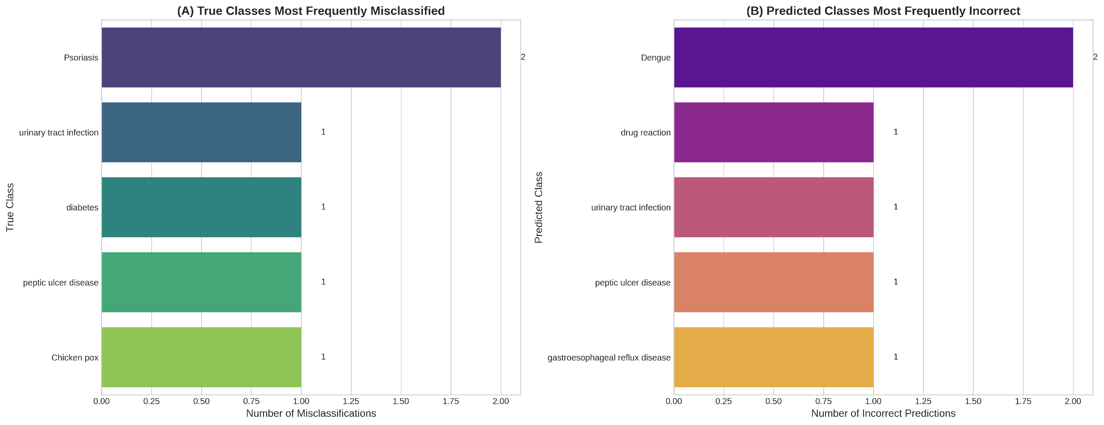
Machine Learning Models Result and Analysis
Figure: Error Analysis (A) True Classes Most Frequently Misclassified (B) Predicted Classes Most Frequently Incorrect
B.Sc. Final-Defense

Slide 21
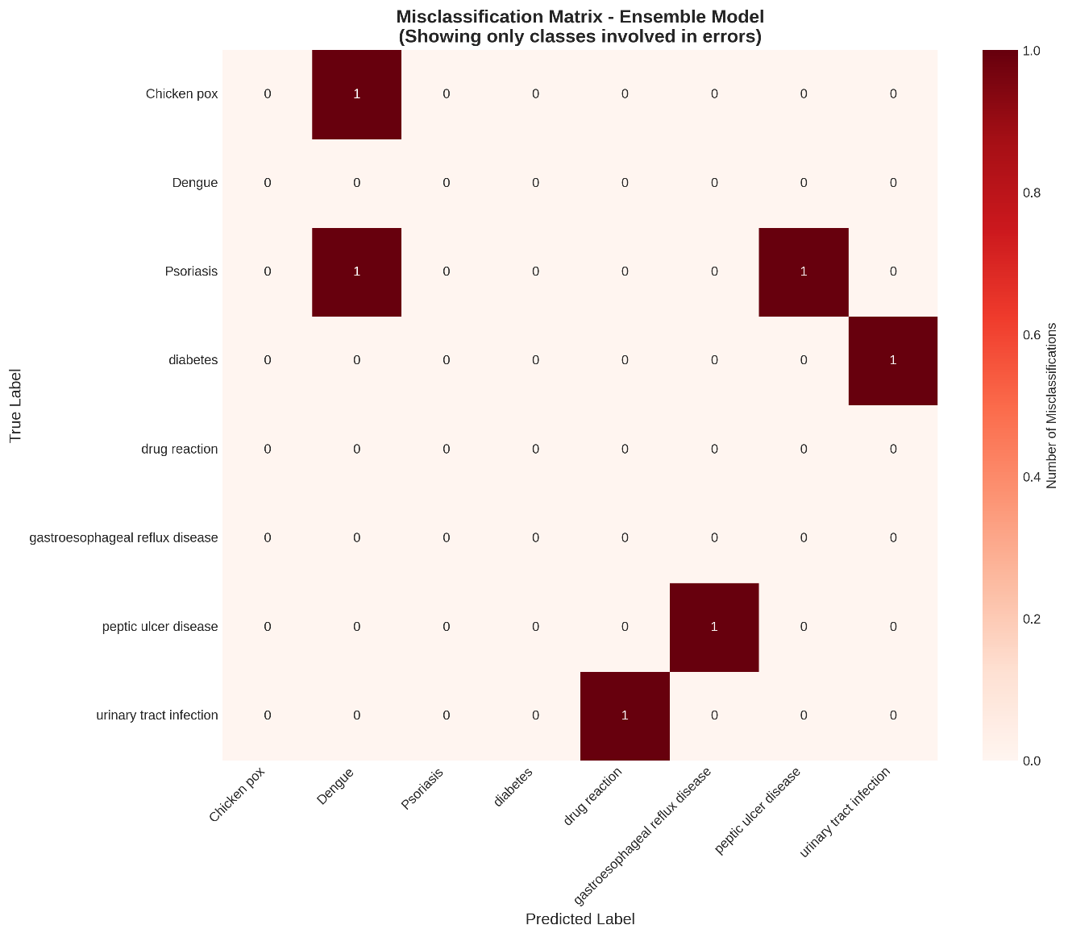
Machine Learning Models Result and Analysis
Figure: Misclassification Matrix – Ensemble Model
B.Sc. Final-Defense

Slide 22
Deep Learning Models Result and Analysis
Why Integrate Deep Learning? To identify the most accurate Transformer model for handling complex, low-confidence queries that the Machine Learning layer could not resolve.
Table: Deep Learning Models Performance
Model | F1-Score | Accuracy | Precision | Recall | MCC | Cohen's Kappa
PubMedBERT (Full Biomedical Pre-training) | 97.80% | 97.84% | 98.10% | 97.84% | 0.9776 | 0.9774
RoBERTa (General) | 97.79% | 97.84% | 98.10% | 97.84% | 0.9776 | 0.9774
DistilBERT | 96.06% | 96.10% | 96.80% | 96.10% | 0.9597 | 0.9593
ClinicalBERT (Clinical) | 96.05% | 96.10% | 96.47% | 96.10% | 0.9596 | 0.9593
BioBERT (Biomedical) | 95.50% | 95.67% | 95.74% | 95.67% | 0.9550 | 0.9548
B.Sc. Final-Defense

Slide 23
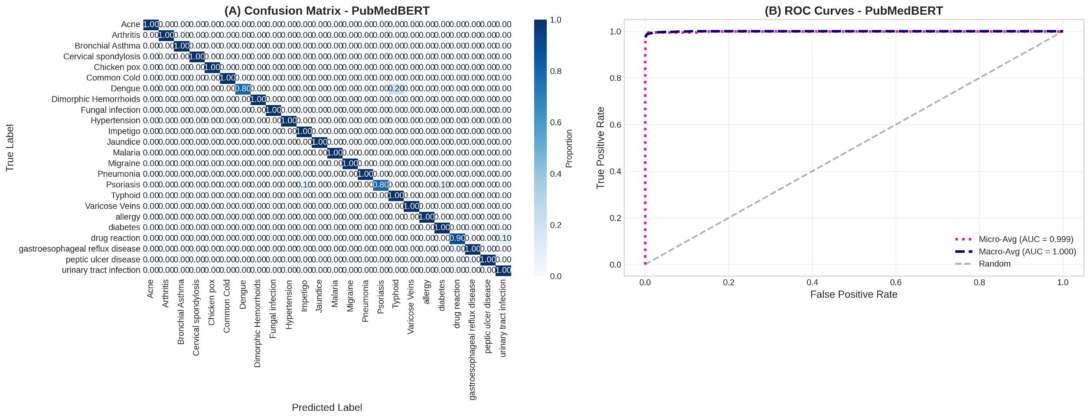
Deep Learning Models Result and Analysis
Figure: (A) Normalized Confusion Matrix and (B) Multi-Class ROC Curves – PubMedBERT
B.Sc. Final-Defense

Slide 24
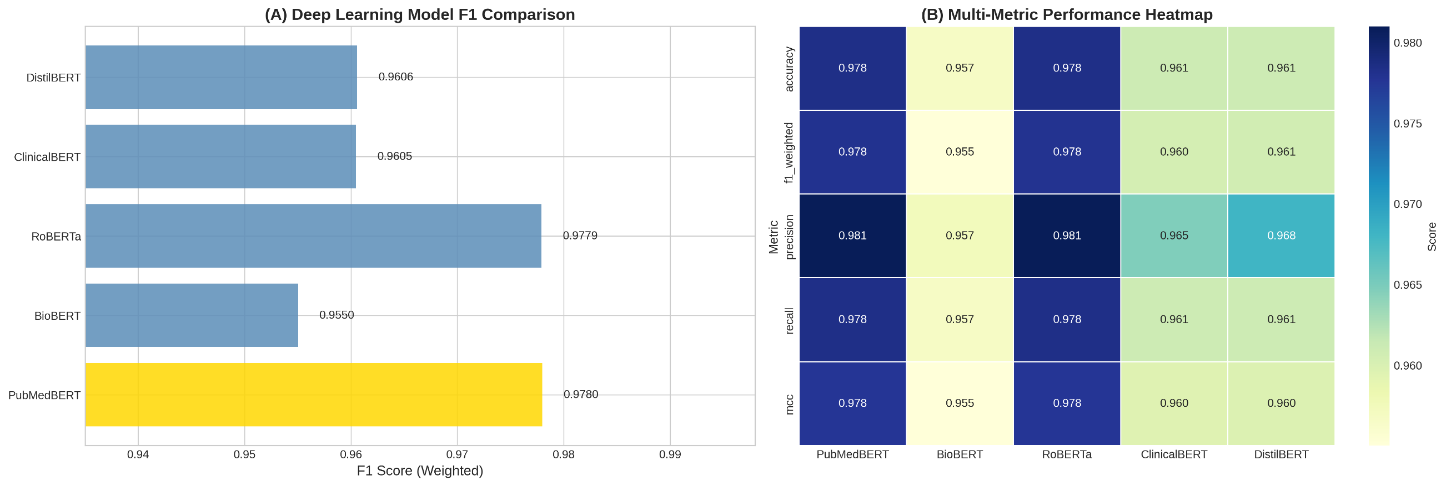
Deep Learning Models Result and Analysis
Figure: (A) DL Model F1 Score Comparison and (B) Multi-Metric Performance Heatmap
B.Sc. Final-Defense

Slide 25
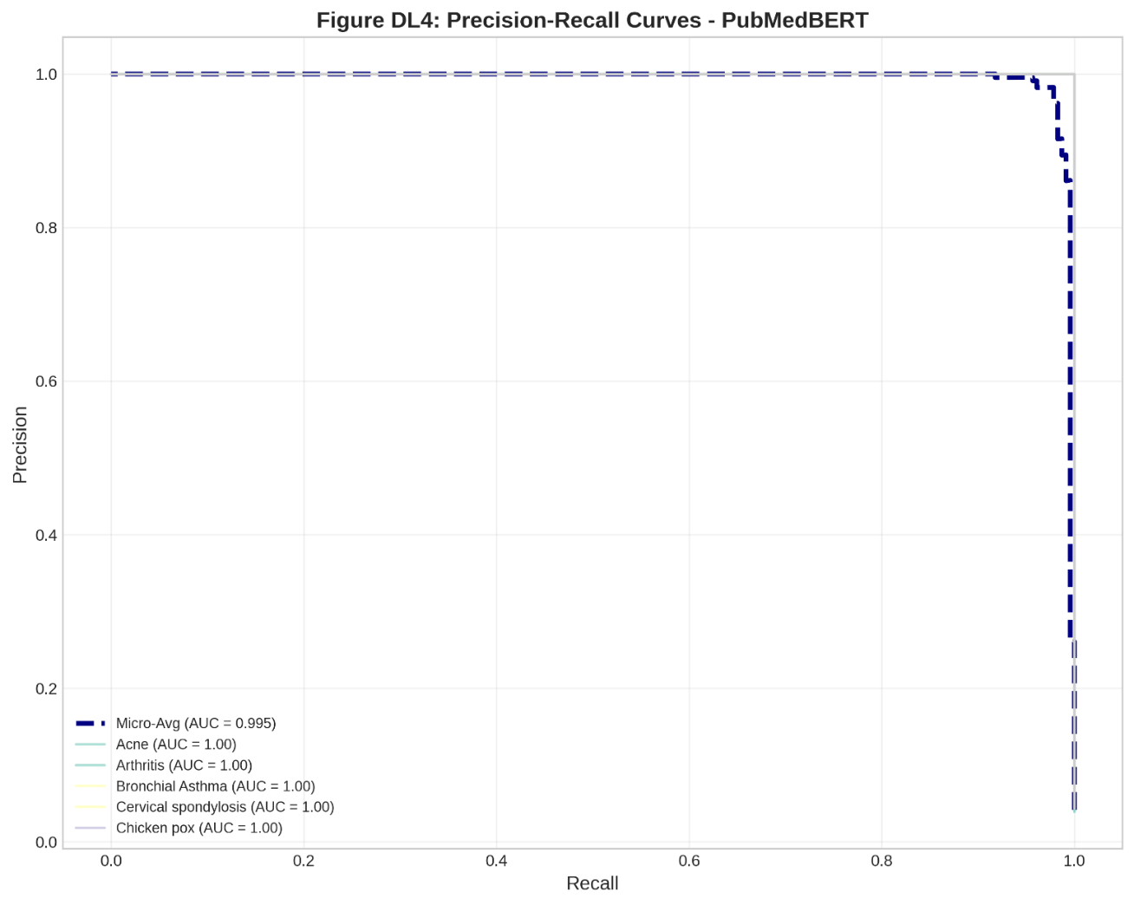
Deep Learning Models Result and Analysis
Figure: Precision–Recall Curves – PubMedBERT
B.Sc. Final-Defense

Slide 26
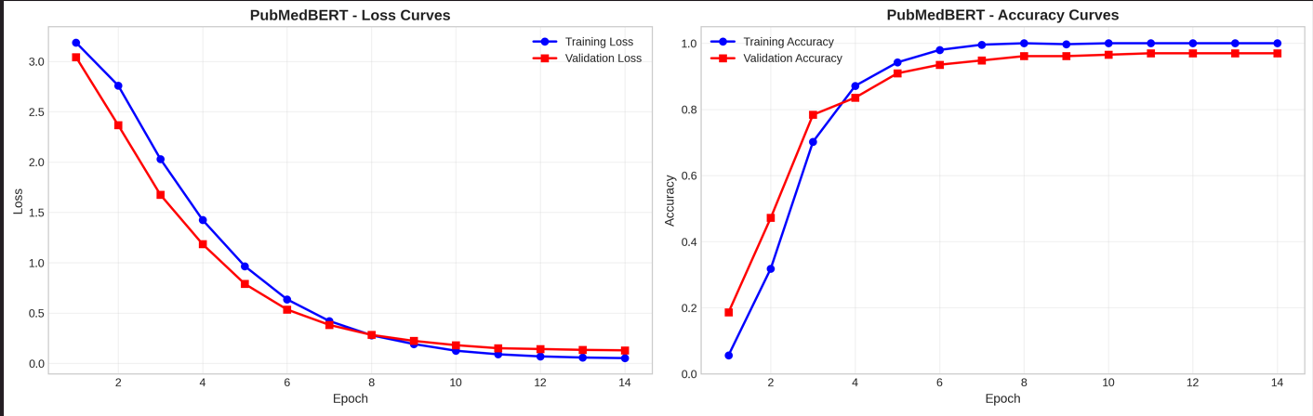
Deep Learning Models Result and Analysis
Figure: Training Loss and Accuracy Curves for PubMedBERT
B.Sc. Final-Defense

Slide 27
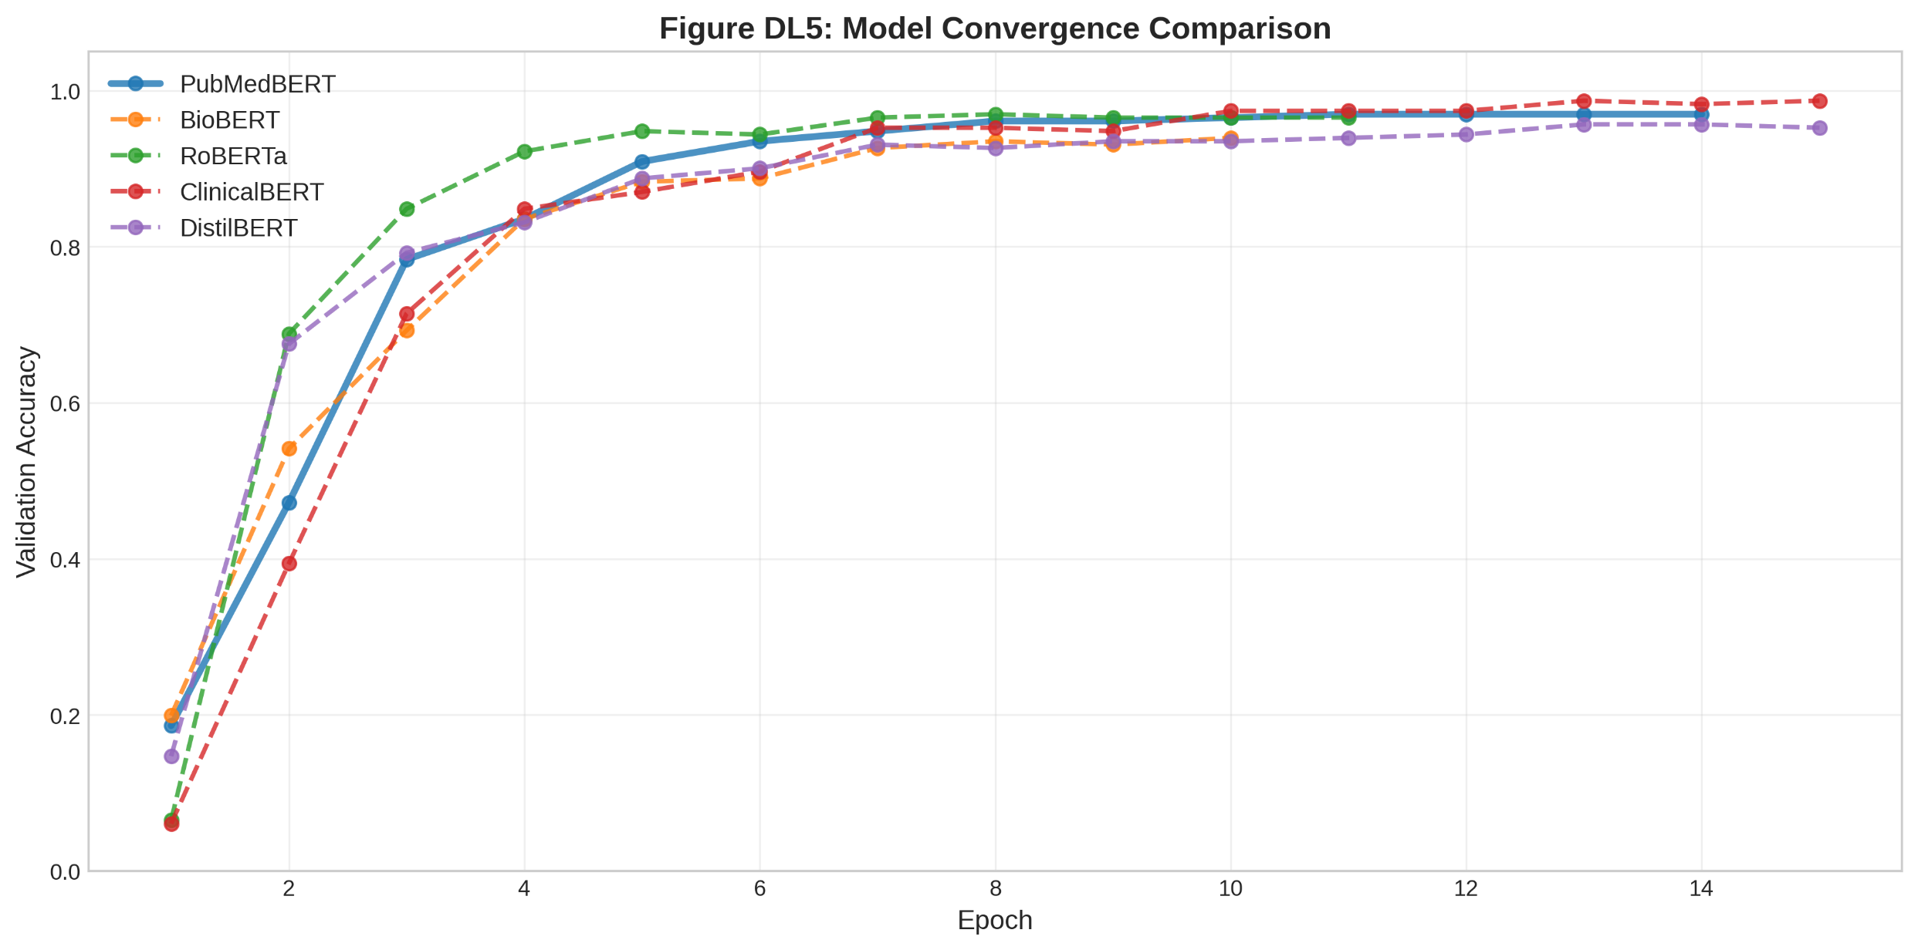
Deep Learning Models Result and Analysis
Figure: Model Convergence Comparison
B.Sc. Final-Defense

Slide 28
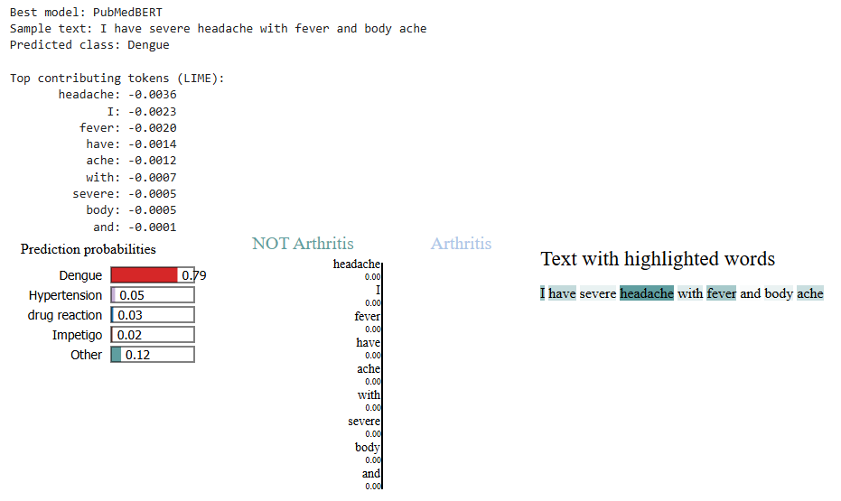
Deep Learning Models Result and Analysis
DL Model Explainability & Trust (LIME):
B.Sc. Final-Defense

Slide 29
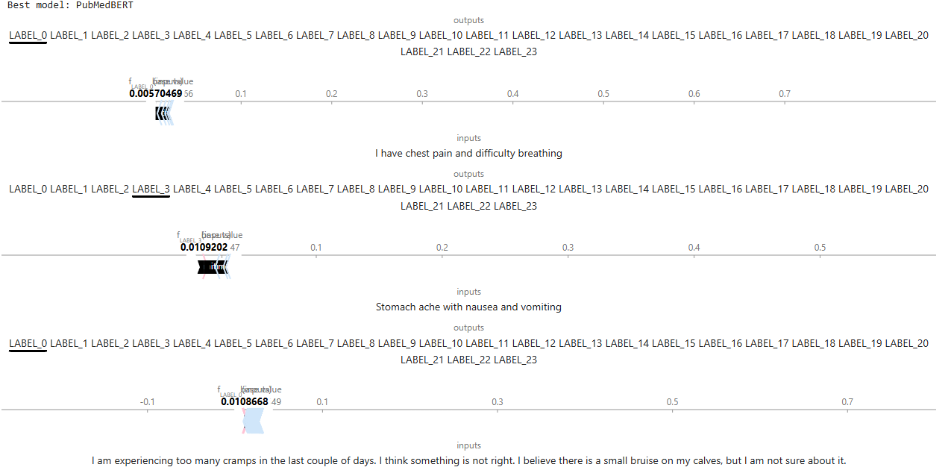
Deep Learning Models Result and Analysis
DL Model Explainability & Trust (SHAP):
B.Sc. Final-Defense

Slide 30
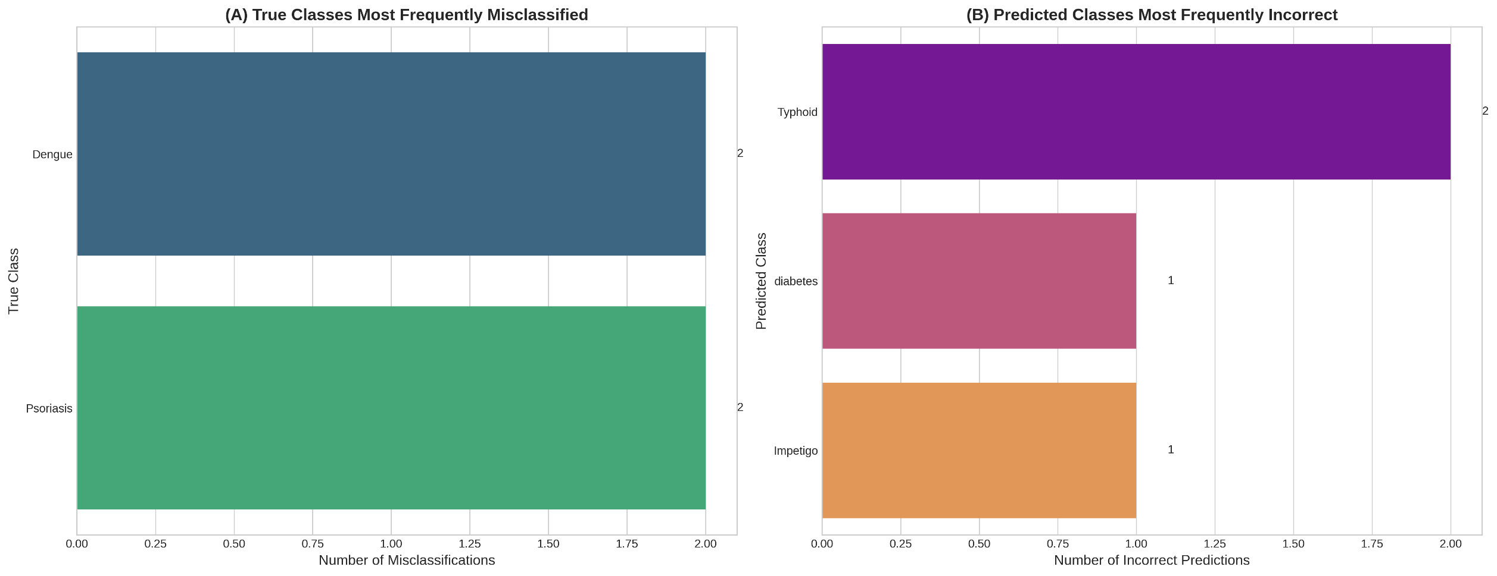
Deep Learning Models Result and Analysis
Figure: Error Analysis (A) True Classes Most Frequently Misclassified (B) Predicted Classes Most Frequently Incorrect
B.Sc. Final-Defense

Slide 31
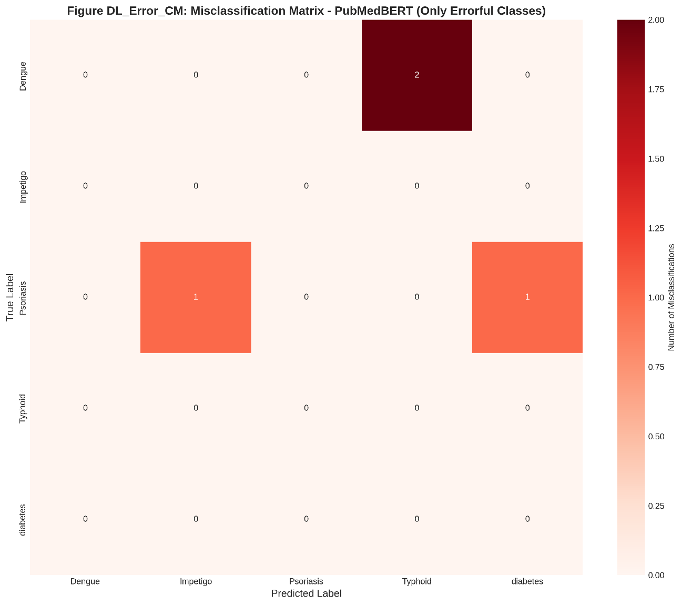
Deep Learning Models Result and Analysis
Figure: Misclassification Matrix – PubMedBERT
B.Sc. Final-Defense

Slide 32
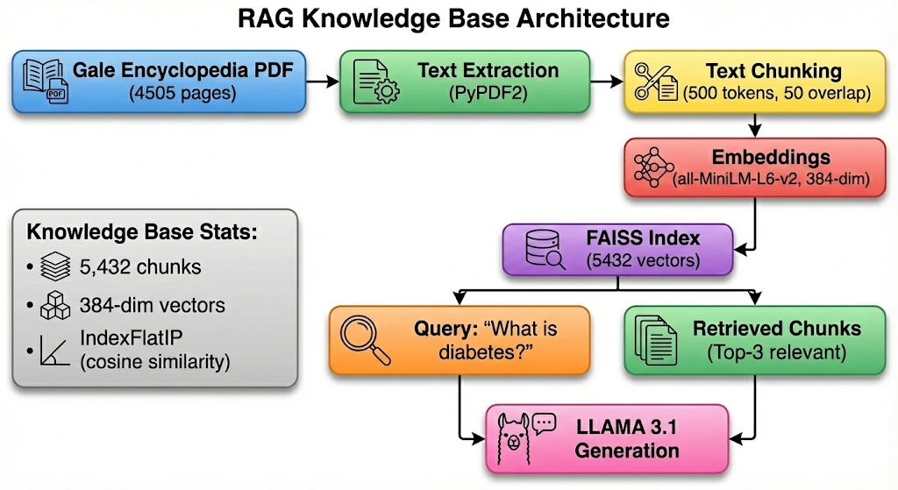
RAG Knowledge Base
Figure: RAG Knowledge Base Architecture
B.Sc. Final-Defense

Slide 33
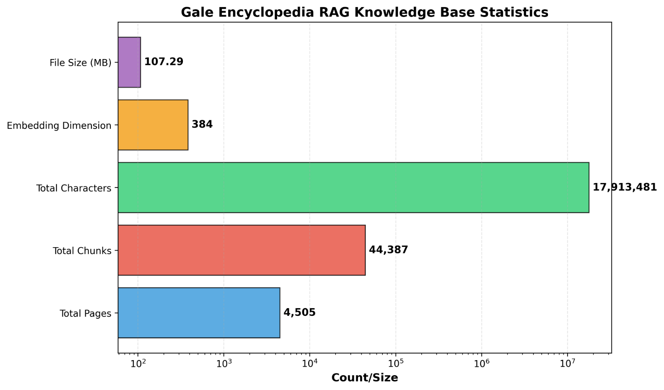
RAG Knowledge Base
Figure: Gale Encyclopedia RAG Knowledge Base Statistics
B.Sc. Final-Defense

Slide 34
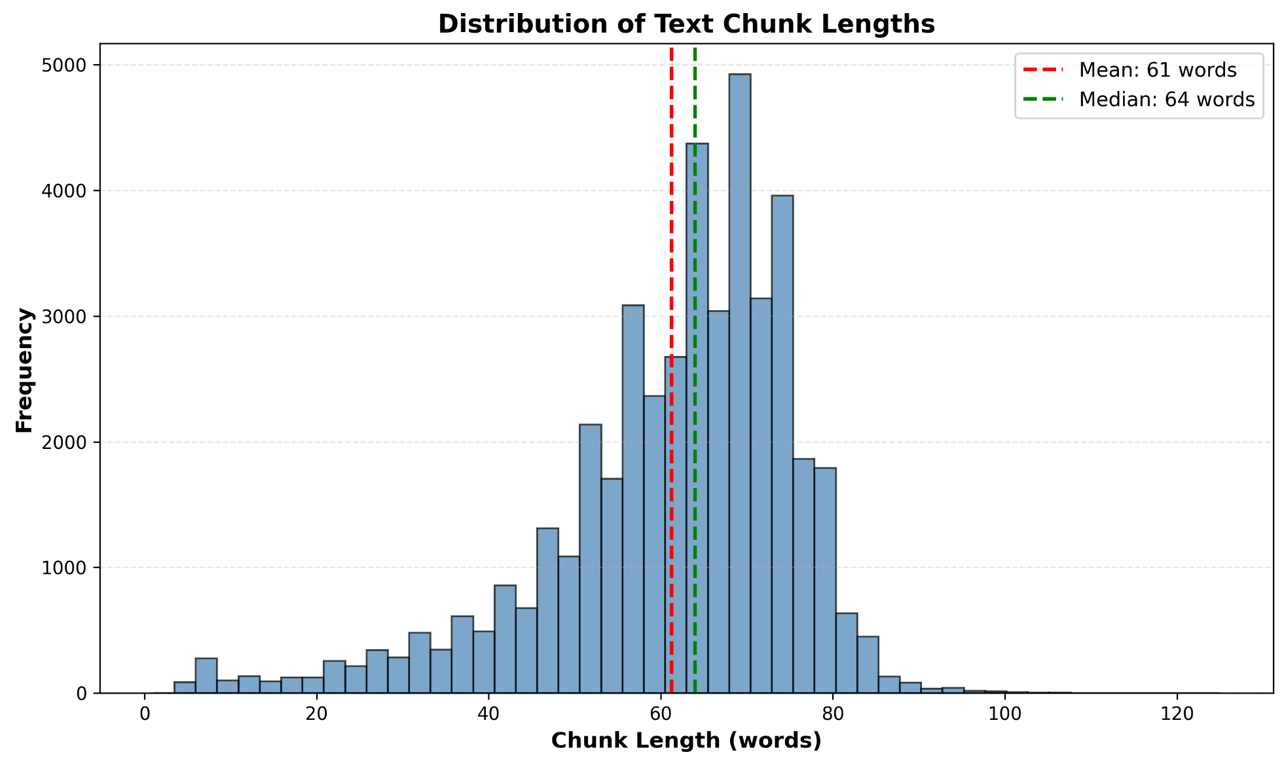
RAG Knowledge Base
Figure: Distribution of Text Chunk Lengths
B.Sc. Final-Defense

Slide 35
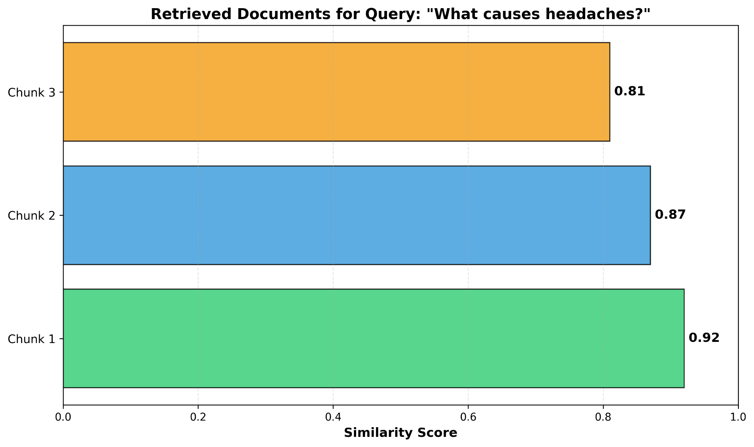
RAG Knowledge Base
Figure: Retrieved Documents for Query: “What causes headaches?” – Similarity Scores
B.Sc. Final-Defense

Slide 36
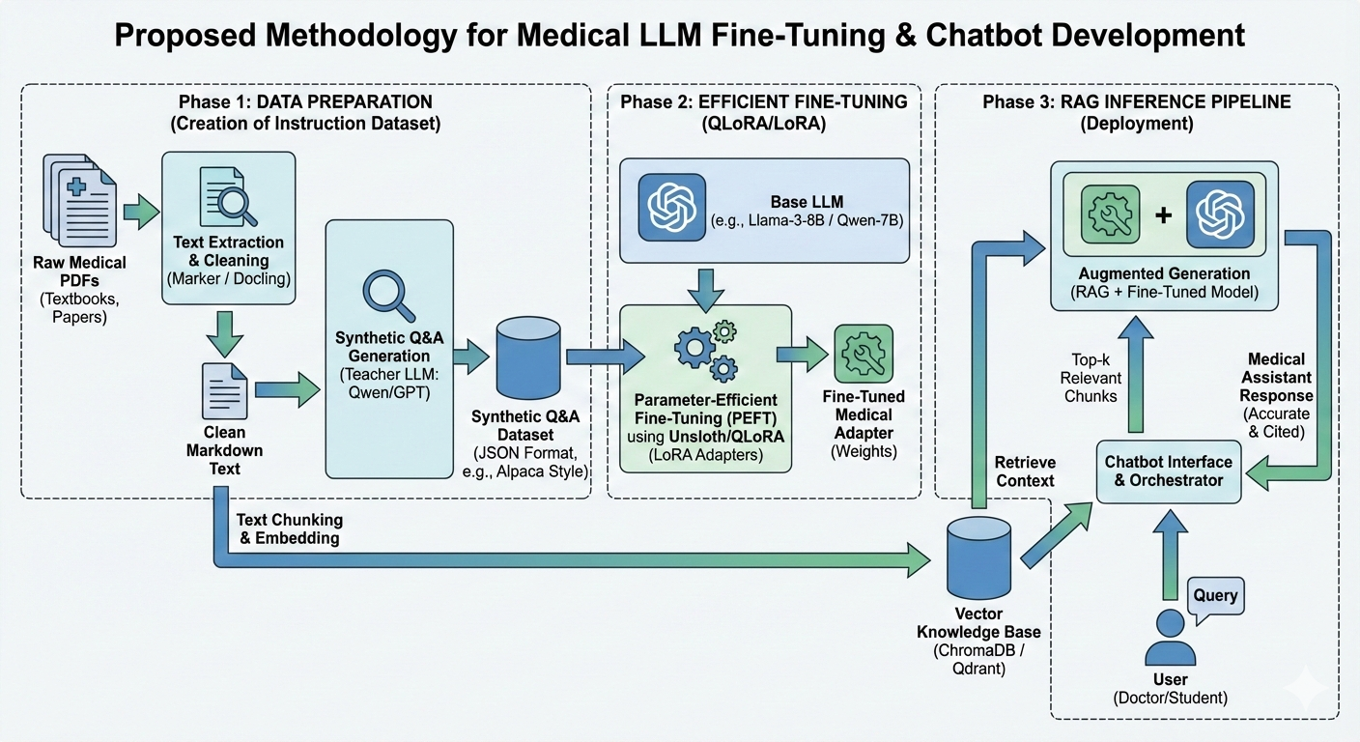
LLM Fine Tune
Figure: Proposed Methodology for Medical LLM Fine-Tuning and Chatbot Development
B.Sc. Final-Defense

Slide 37
Novelty of the Work
Cascading Architecture: Novel dynamic routing based on prediction confidence (0.95 threshold) optimizes resource usage (74% queries handled by fast ML).
Hybrid RAG Integration: Combines structured prediction with unstructured knowledge retrieval from a verified medical encyclopedia.
Dual Explainability: Uniquely integrates global citations (RAG) with local visual explanations (LIME/SHAP).
Deployment Ready: Full-stack implementation with "graceful degradation" for low-confidence queries.
B.Sc. Final-Defense

Slide 38
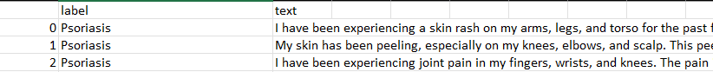
Sample dataset
Structured Dataset: Symptom2Disease dataset (24 classes, 1,200 samples)
Class Names: ['Acne', 'Arthritis', 'Bronchial Asthma', 'Cervical spondylosis', 'Chicken pox', 'Common Cold', 'Dengue', 'Dimorphic Hemorrhoids', 'Fungal infection', 'Hypertension', 'Impetigo', 'Jaundice', 'Malaria', 'Migraine', 'Pneumonia', 'Psoriasis', 'Typhoid', 'Varicose Veins', 'allergy', 'diabetes', 'drug reaction', 'gastroesophageal reflux disease', 'peptic ulcer disease', 'urinary tract infection']
Knowledge Base:
Gale Encyclopedia of Medicine 3rd Edition PDF (4,505 pages)
B.Sc. Final-Defense

Slide 39
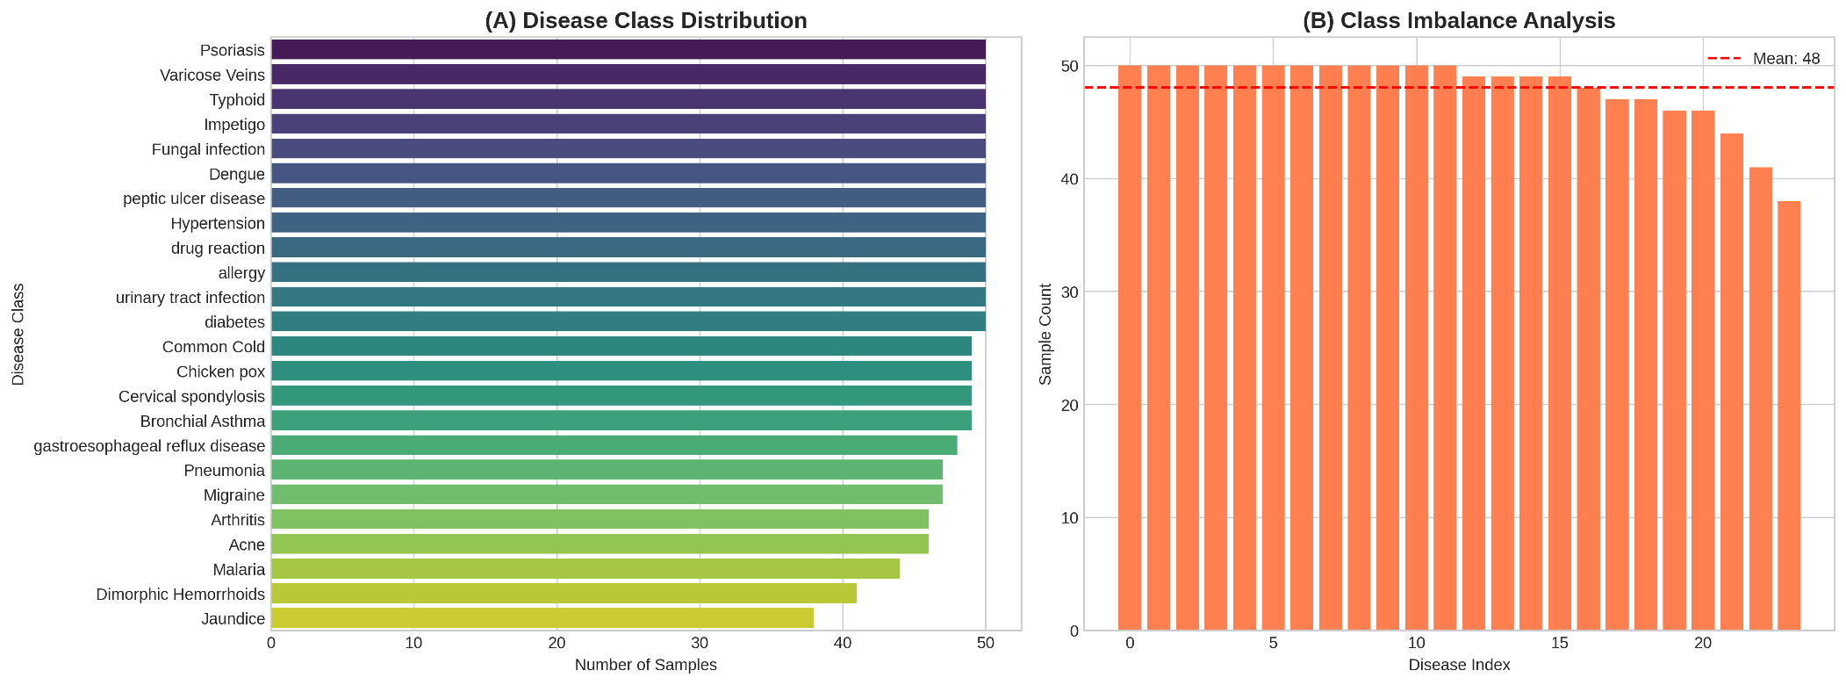
Sample dataset Cont.
Figure: (A) Disease Class Distribution and (B) Class Imbalance Analysis
B.Sc. Final-Defense

Slide 40
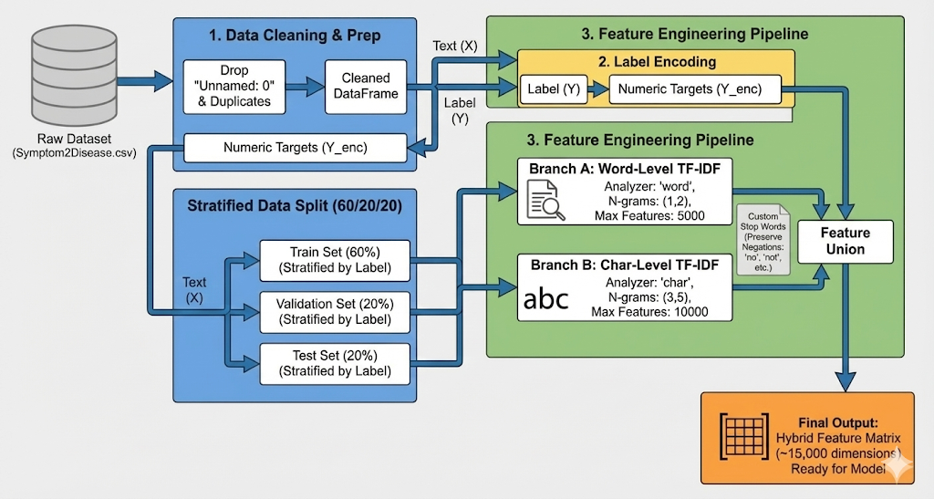
Sample dataset Cont.
Figure: Dataset Preprocessing Diagram
B.Sc. Final-Defense

Slide 41
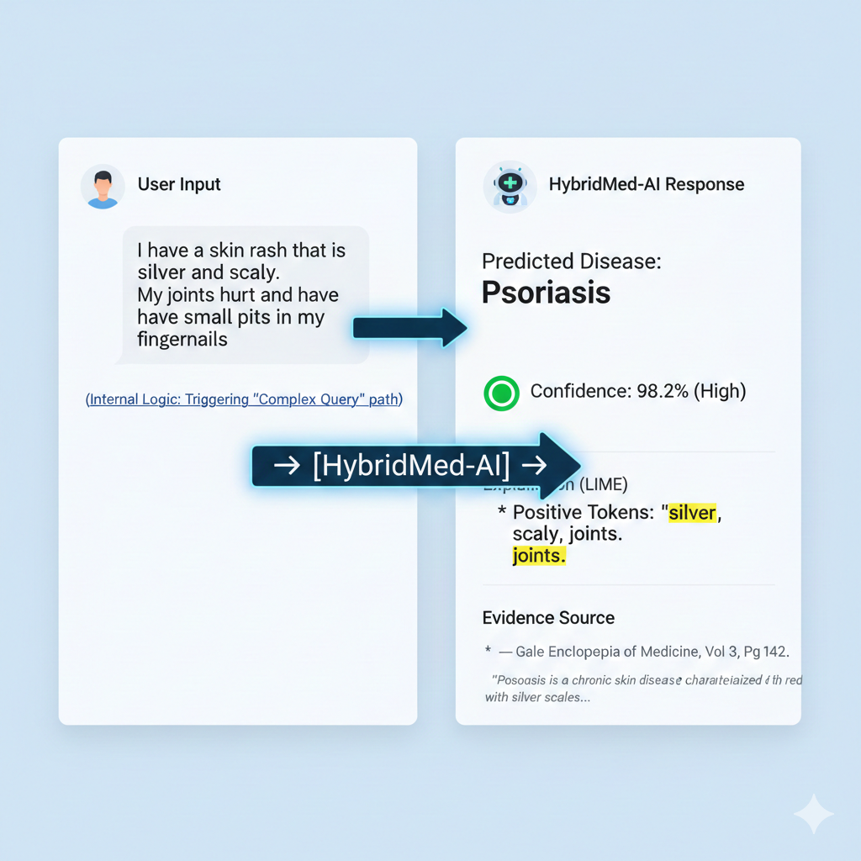
Sample dataset and Expected output
Sample dataset | Expected Output
I am experiencing too many cramps in the last couple of days. I think something is not right. I believe there is a small bruise on my calves, but I am not sure about it. | Predicted Condition(Varicose Veins)
I've been really itchy lately and there are these rashy spots all over my skin. There are also some areas that don't look like the normal color of my skin, and I've had some bumps that are kind of hard | Predicted Condition(Fungal infection)
Same as rest 22 disease samples…
what is diabetes? | Diabetes is a metabolic disorder characterised by hyperglycaemia resulting from either insufficient secretion of insulin or its ineffectiveness.
B.Sc. Final-Defense

Slide 42
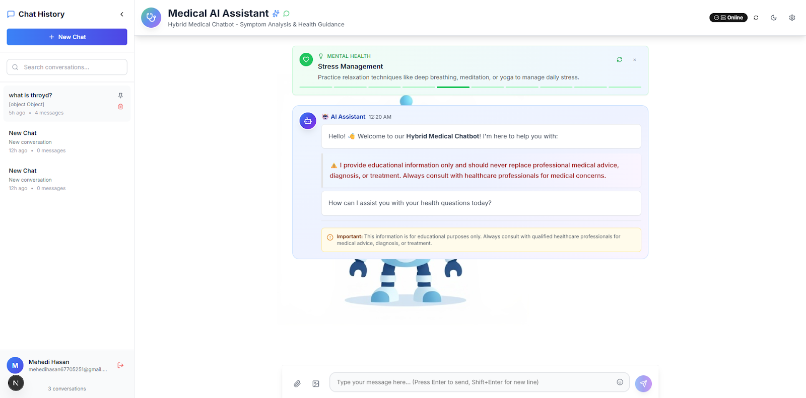
Web Interface of Image Enhancement
B.Sc. Final-Defense

Slide 43
Conclusion
Summary: Successfully developed a hybrid chatbot that outperforms single-model approaches in accuracy and efficiency.
Impact: Demonstrates that multi-paradigm integration (ML + DL + RAG) restores user trust through transparency.
Limitations: Knowledge base limited to Gale Encyclopedia; dependence on English language inputs.
Future Work:
Knowledge Base Expansion: Incorporate specialized textbooks (e.g., Harrison’s Principles of Internal Medicine, Gray's Anatomy) to cover rare pathologies.
Multilingual Support: Integrate translation layers to support Bengali and Spanish for rural telemedicine access.
Electronic Health Record (EHR) Integration: Allow the chatbot to access patient history for personalized risk assessment.
Doctor-in-the-Loop:Implement a dashboard for real doctors to verify "Low Confidence" (Red flag) cases.
B.Sc. Final-Defense

Slide 44
References
N. Barman, “Symptom2Disease,” Kaggle dataset. Available: https://www.kaggle.com/datasets/niyarrbarman/symptom2disease.
K. L. F. Gale, The Gale Encyclopedia of Medicine, 3rd ed. Detroit, MI, USA: Gale Group, 2014. Available: https://staibabussalamsula.ac.id/wp-content/uploads/2024/06/The-Gale-Encyclopedia-of-Medicine-3rd-Edition-staibabussalamsula.ac_.id_.pdf.
S. Wang et al., “Enhancing medical AI with retrieval-augmented generation,” NIH National Library of Medicine, 2024. Available: https://pmc.ncbi.nlm.nih.gov/articles/PMC12059965.
A. K. Patel et al., “Retrieval-augmented generation in healthcare,” Healthcare, vol. 6, no. 9, p. 226, 2024, doi: 10.3390/healthcare6090226.
J. Li et al., “Development and evaluation of a retrieval-augmented generation system for clinical decision support,” JMIR AI, vol. 1, p. e75262, 2025. Available: https://ai.jmir.org/2025/1/e75262.
M. Hasan et al., “SymptoTrackAI: Hybrid RAG chatbot for symptom monitoring,” ResearchGate, 2025. Available: https://www.researchgate.net/publication/395825116_SymptoTrackAI_Hybrid_RAG_Chatbot_for_Symptom_Monitoring.
A. Rahman et al., “AI for customized treatments with RAG and large language models,” Int. J. Innovative Sci. Res. Technol., vol. 10, no. 6, pp. 1–10, 2025. Available: https://www.ijisrt.com/assets/upload/files/IJISRT25JUN282.pdf.
M. Zhao et al., “A survey on retrieval-augmented generation models,” Neural Computing and Applications, 2025, doi: 10.1007/s00521-025-11666-9.
S. Verma et al., “Research on AI-powered medical chatbot using RAG,” Int. J. Sci. Res. Eng. Technol., 2025. Available: https://ijsret.com/2025/07/26/research-on-ai-powered-medical-chat-bot-using-rag/.
R. Gupta et al., “Transforming healthcare with chatbots: Uses and applications,” NIH National Library of Medicine, 2024. Available: https://pmc.ncbi.nlm.nih.gov/articles/PMC11915287/.
B.Sc. Final-Defense

Slide 45
THANK YOU
Any Questions?
B.Sc. Final-Defense

